Slide 1
Telecom Customer Churn Analysis
DEPI MINI PROJECT
Cleaning, modeling, visualizing and interpreting data from 7,043 telecom customers to understand why customers leave and how to keep them.
7,043
26.5%
26
30.5%
Customers
Churn rate
Variables (21 original + 5 engineered)
of monthly charges tied to churned customers
Python → SQL → Power BI → Business Analysis → Recommendations
Notes:
Welcome. This project analyzes a telecom customer dataset to understand why customers leave (churn) and what the company can do about it.
The work moves through four stages: Python, SQL, Power BI, and Business Analysis.

Slide 2
Meet the Team
AM
MK
ME
RH
ZE
Asmaa
Mahmoud
Mariam
Renad
Zakarya
Mostafa
Kosbar
Ehab
Al Haddad
Elbreshy
DEPI Track · Data Analysis Mini Project
Notes:
Introduce the team. Each member will present their own part: what they did and how they did it, then introduce the next person.

Slide 3
Presentation Roadmap
01
Data Preparation & EDA
Cleaning the raw dataset, exploring churn patterns and engineering new features.
02
Database & Advanced SQL
A star schema in SQL Server, data cleaning, CTEs, ranking, views and analysis queries.
03
Power BI Dashboard
Three interactive pages: Overview, Customer Insights and Financial Analysis.
04
Business Analysis
KPIs, churn drivers, insights and recommendations.
DATA FLOW
Raw CSV
→
Python
→
SQL Server
→
Power BI
→
Insights
Notes:
The business question: why do telecom customers leave, and what can we do about it?
Data flow: the raw CSV is cleaned and enriched in Python, loaded into SQL Server as a star schema, visualized in Power BI, then turned into insights and recommendations.

Slide 4
Data Preparation & EDA
01
Loading, cleaning and exploring the raw dataset, then engineering features for SQL and Power BI.
Notes:
Section 1: Python. We load the raw data, check its quality, fix problems, explore churn patterns and create new features.

Slide 5
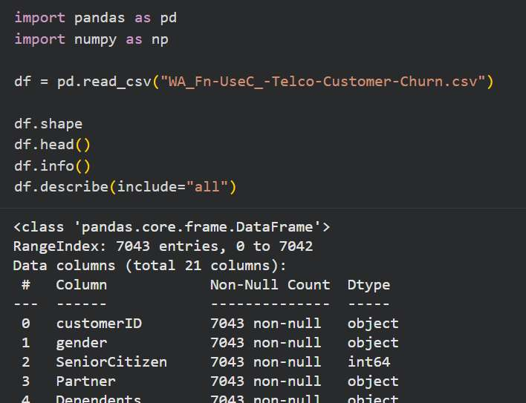
Loading the Raw Telco Dataset
WHAT WAS DONE
Loaded the raw telecom customer file and inspected its size, columns and data types.
HOW
pandas read_csv, then df.shape, head(), info() and describe(include='all').
Key insight: The raw file holds 7,043 customer records across 21 columns.
i
Notes:
What we did: Loaded the raw telecom customer file and inspected its size, columns and data types.
How: pandas read_csv, then df.shape, head(), info() and describe(include='all').
Key point: The raw file holds 7,043 customer records across 21 columns.

Slide 6
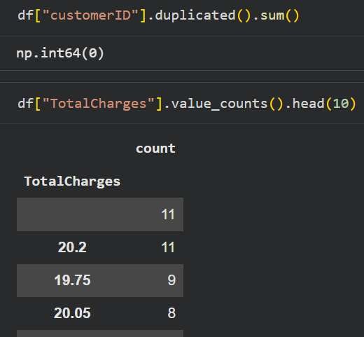
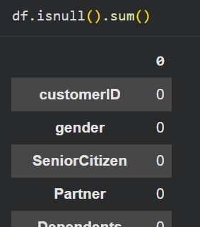
No Nulls, No Duplicate Customer IDs
WHAT WAS DONE
Checked every column for missing values, customerID for duplicates, and the most common TotalCharges values.
HOW
df.isnull().sum(), customerID.duplicated().sum() and TotalCharges.value_counts().
Key insight: Zero nulls and zero duplicate IDs, but TotalCharges quietly hides 11 blank entries.
i
Notes:
What we did: Checked every column for missing values, customerID for duplicates, and the most common TotalCharges values.
How: df.isnull().sum(), customerID.duplicated().sum() and TotalCharges.value_counts().
Key point: Zero nulls and zero duplicate IDs, but TotalCharges quietly hides 11 blank entries.

Slide 7
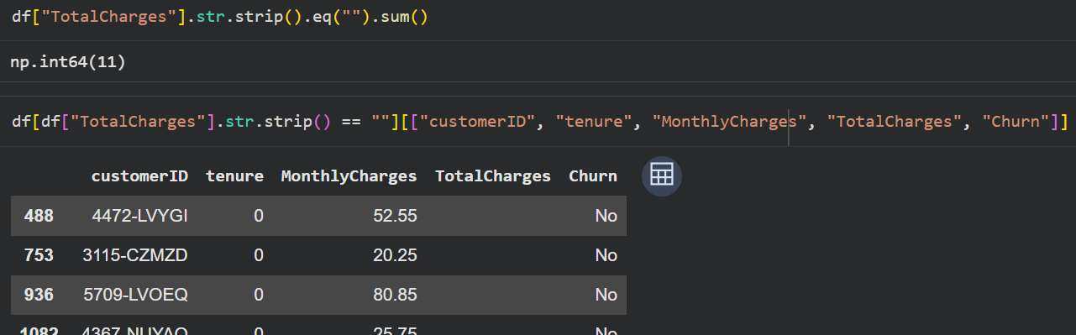
11 Blank TotalCharges Values Found
WHAT WAS DONE
Isolated the blank TotalCharges entries that isnull() could not see.
HOW
Filtered rows where TotalCharges.str.strip() equals an empty string and listed their key columns.
Key insight: All 11 blank values belong to customers with tenure 0: brand-new customers who have not been billed yet.
i
Notes:
What we did: Isolated the blank TotalCharges entries that isnull() could not see.
How: Filtered rows where TotalCharges.str.strip() equals an empty string and listed their key columns.
Key point: All 11 blank values belong to customers with tenure 0: brand-new customers who have not been billed yet.

Slide 8
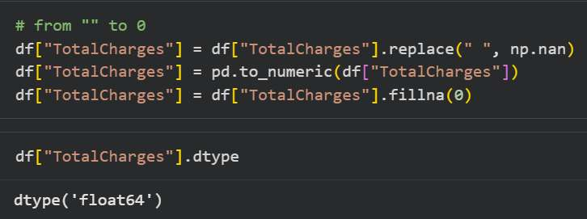
Fixing the TotalCharges Column
WHAT WAS DONE
Converted TotalCharges from text to a numeric column and filled the blanks with 0.
HOW
Replaced blanks with NaN, pd.to_numeric(), then fillna(0).
Key insight: A new customer has paid nothing yet, so 0 is a sensible fill, and the column is now a clean float64.
i
Notes:
What we did: Converted TotalCharges from text to a numeric column and filled the blanks with 0.
How: Replaced blanks with NaN, pd.to_numeric(), then fillna(0).
Key point: A new customer has paid nothing yet, so 0 is a sensible fill, and the column is now a clean float64.

Slide 9
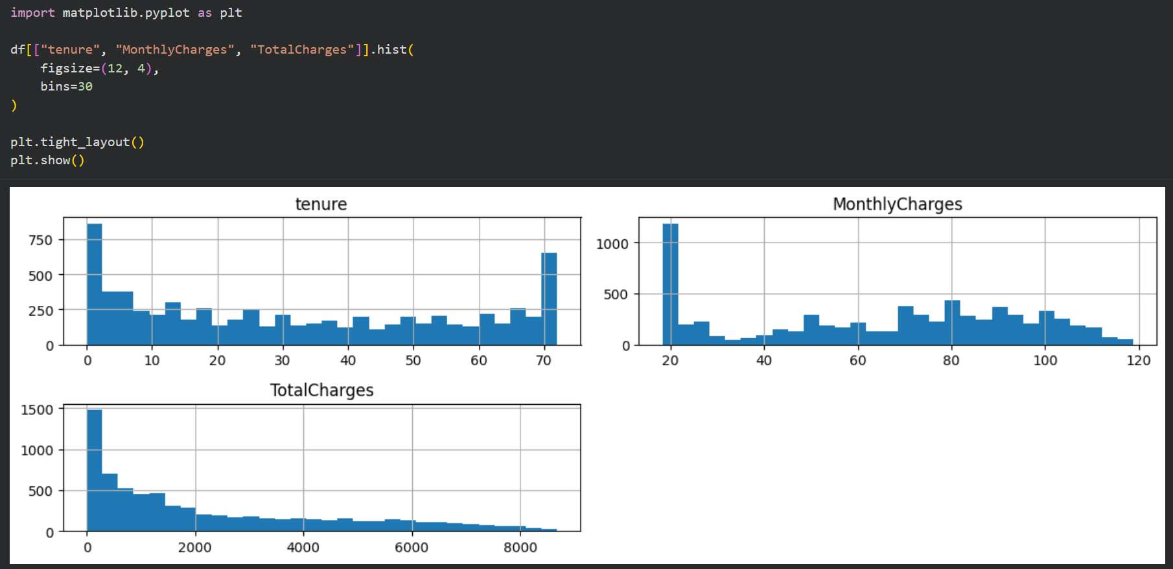
Distributions of the Numeric Features
WHAT WAS DONE
Plotted tenure, MonthlyCharges and TotalCharges to see how customers are spread.
HOW
df[[...]].hist() with 30 bins.
Key insight: Tenure peaks at both ends, with many brand-new and many long-term customers, and TotalCharges is right-skewed.
i
Notes:
What we did: Plotted tenure, MonthlyCharges and TotalCharges to see how customers are spread.
How: df[[...]].hist() with 30 bins.
Key point: Tenure peaks at both ends, with many brand-new and many long-term customers, and TotalCharges is right-skewed.

Slide 10
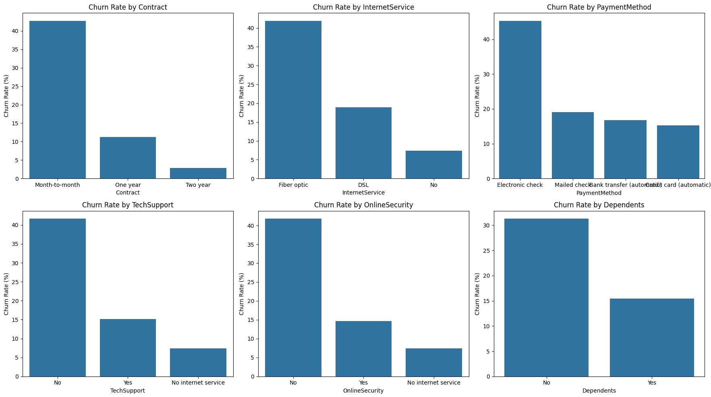
Churn Rate by Key Factors
WHAT WAS DONE
Compared churn rates across contract, internet service, payment method, tech support, online security and dependents.
HOW
A 2×3 grid of bar charts showing churn rate (%) for each category.
Key insight: Month-to-month contracts, fiber optic and electronic check show the highest churn, and customers with tech support or security churn far less.
i
Notes:
What we did: Compared churn rates across contract, internet service, payment method, tech support, online security and dependents.
How: A 2×3 grid of bar charts showing churn rate (%) for each category.
Key point: Month-to-month contracts, fiber optic and electronic check show the highest churn, and customers with tech support or security churn far less.

Slide 11
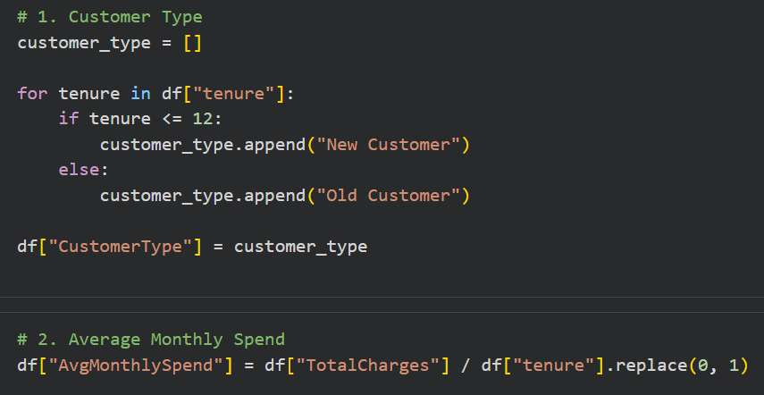
Feature Engineering: Customer Type & Spend
WHAT WAS DONE
Created CustomerType (new or old) and AvgMonthlySpend.
HOW
Tenure of 12 months or less is a New Customer. AvgMonthlySpend is TotalCharges divided by tenure, with tenure 0 treated as 1.
Key insight: Two new columns describe how long a customer has been with the company and what they typically spend.
i
Notes:
What we did: Created CustomerType (new or old) and AvgMonthlySpend.
How: Tenure of 12 months or less is a New Customer. AvgMonthlySpend is TotalCharges divided by tenure, with tenure 0 treated as 1.
Key point: Two new columns describe how long a customer has been with the company and what they typically spend.

Slide 12
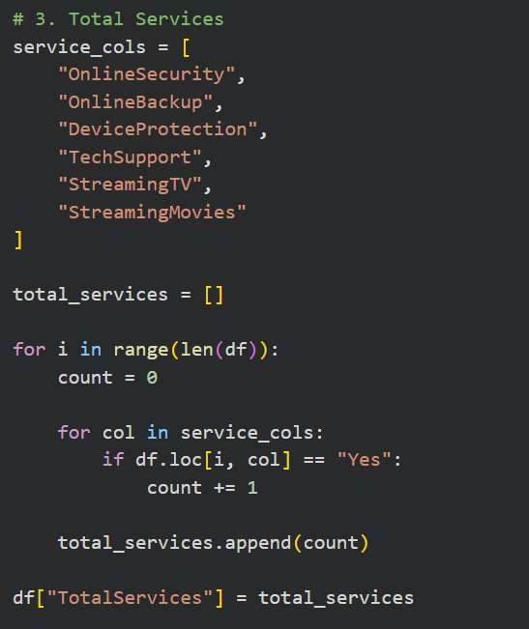
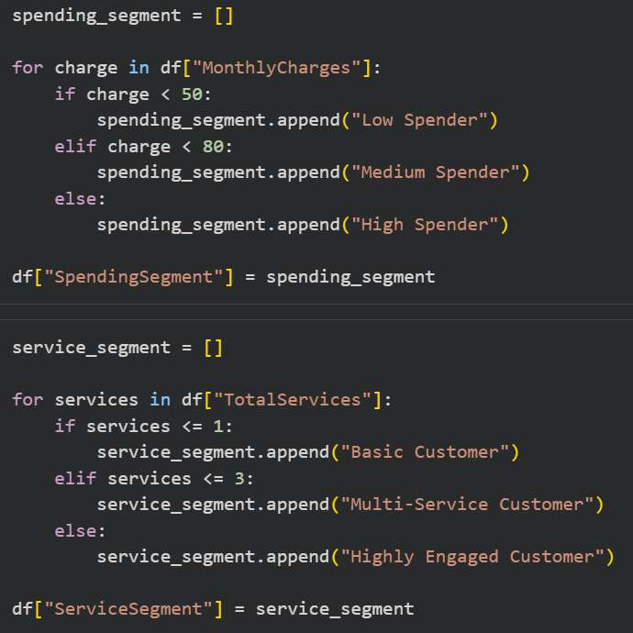
Feature Engineering: Services & Segments
WHAT WAS DONE
Counted each customer's add-on services, then segmented customers by spending and service level.
HOW
TotalServices counts 6 add-ons. Spend: under 50, 50 to 80, 80+. Services: 0 to 1, 2 to 3, 4+.
Key insight: Customers now fall into spending segments (low, medium, high) and service segments (basic, multi-service, highly engaged).
i
Notes:
What we did: Counted each customer's add-on services, then segmented customers by spending and service level.
How: TotalServices counts 6 add-ons. Spend: under 50, 50 to 80, 80+. Services: 0 to 1, 2 to 3, 4+.
Key point: Customers now fall into spending segments (low, medium, high) and service segments (basic, multi-service, highly engaged).

Slide 13

Saving the Final Dataset
WHAT WAS DONE
Exported the cleaned, enriched dataset for SQL and Power BI.
HOW
df.to_csv('Mini V2 py.csv', index=False).
Key insight: The output is 7,043 rows × 26 columns (21 original plus 5 engineered), ready to load into the database.
i
Notes:
What we did: Exported the cleaned, enriched dataset for SQL and Power BI.
How: df.to_csv('Mini V2 py.csv', index=False).
Key point: The output is 7,043 rows × 26 columns (21 original plus 5 engineered), ready to load into the database.

Slide 14
Database & Advanced SQL
02
Building a star schema in SQL Server, analyzing churn with SQL queries, then going deeper with CTEs, ranking, window functions and views.
Notes:
Section 2: SQL. The Python output becomes the data_after_py table. First we build a star schema, then we analyze churn with SQL queries, then we use advanced SQL: a CTE, RANK, window functions and a view.

Slide 15
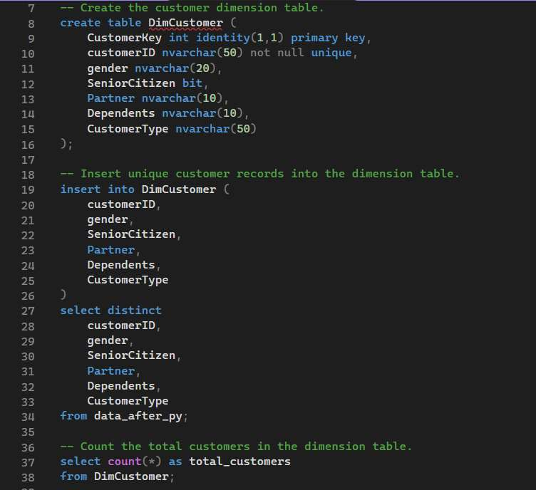
Dimension Table: DimCustomer
WHAT WAS DONE
Created the customer dimension: one row per customer, with a surrogate key.
HOW
CREATE TABLE with an identity primary key and a unique customerID, INSERT DISTINCT from data_after_py, then COUNT(*) to check the rows.
Key insight: Every customer gets a unique CustomerKey. DimContract, DimInternetService and DimPaymentMethod are built the same way.
i
Notes:
What we did: Created the customer dimension: one row per customer, with a surrogate key.
How: CREATE TABLE with an identity primary key and a unique customerID, INSERT DISTINCT from data_after_py, then COUNT(*) to check the rows.
Key point: Every customer gets a unique CustomerKey. DimContract, DimInternetService and DimPaymentMethod are built the same way.

Slide 16
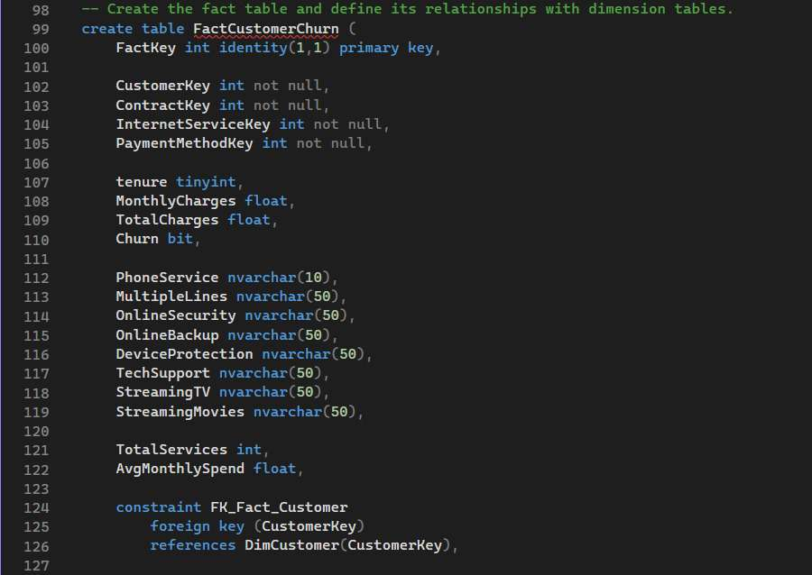
Fact Table: FactCustomerChurn
WHAT WAS DONE
Defined the fact table that holds the measures and the keys to the four dimensions.
HOW
An identity primary key, four key columns, tenure, charges, churn and service columns, then FOREIGN KEY constraints to the dimensions.
Key insight: One central fact table: the numbers (tenure, charges, churn, services) plus a key to each dimension.
i
Notes:
What we did: Defined the fact table that holds the measures and the keys to the four dimensions.
How: An identity primary key, four key columns, tenure, charges, churn and service columns, then FOREIGN KEY constraints to the dimensions.
Key point: One central fact table: the numbers (tenure, charges, churn, services) plus a key to each dimension.

Slide 17
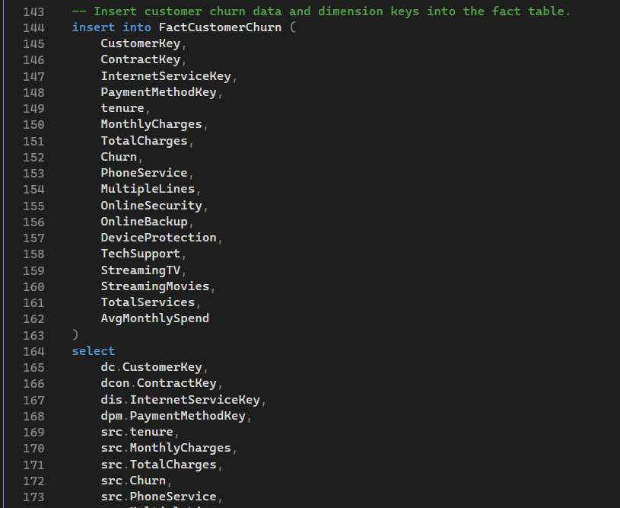
Loading the Fact Table (1 of 2)
WHAT WAS DONE
Started filling the fact table from the Python output.
HOW
INSERT INTO FactCustomerChurn with its column list, then a SELECT of the dimension keys and the values from data_after_py.
Key insight: The column list maps every fact column to a value from the source table or to a dimension key.
i
Notes:
What we did: Started filling the fact table from the Python output.
How: INSERT INTO FactCustomerChurn with its column list, then a SELECT of the dimension keys and the values from data_after_py.
Key point: The column list maps every fact column to a value from the source table or to a dimension key.

Slide 18
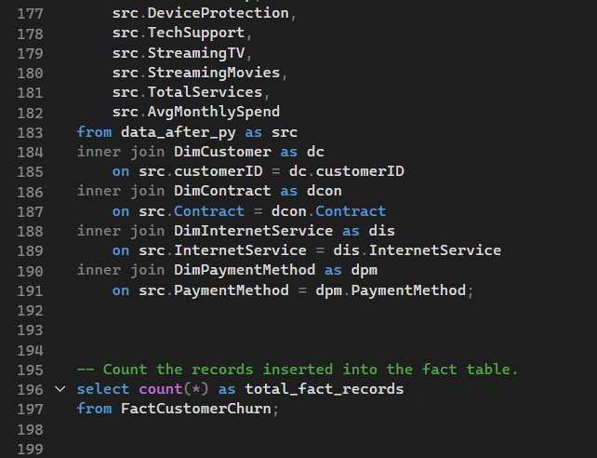
Loading the Fact Table (2 of 2)
WHAT WAS DONE
Joined the source table to the four dimensions to look up each key, then counted the inserted rows.
HOW
INNER JOINs from data_after_py to DimCustomer, DimContract, DimInternetService and DimPaymentMethod, then SELECT COUNT(*) on the fact table.
Key insight: The joins attach the correct key from every dimension to each fact row.
i
Notes:
What we did: Joined the source table to the four dimensions to look up each key, then counted the inserted rows.
How: INNER JOINs from data_after_py to DimCustomer, DimContract, DimInternetService and DimPaymentMethod, then SELECT COUNT(*) on the fact table.
Key point: The joins attach the correct key from every dimension to each fact row.

Slide 19
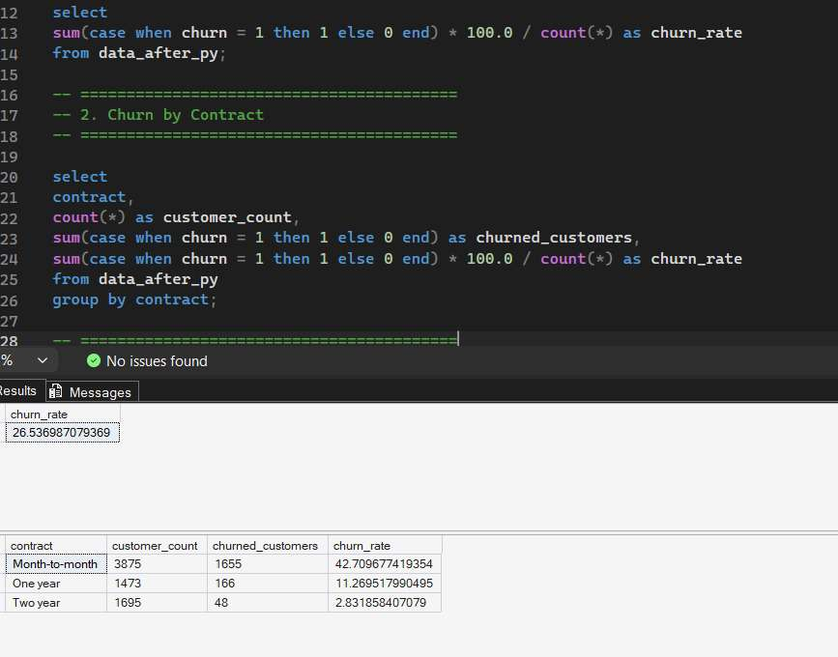
Overall Churn Rate and Churn by Contract
WHAT WAS DONE
Calculated the overall churn rate, then the churn rate for each contract type.
HOW
SUM(CASE WHEN churn = 1 ...) × 100.0 ÷ COUNT(*) on data_after_py, then the same grouped by contract.
Key insight: Overall churn is 26.54%, but month-to-month contracts churn at 42.71% versus 11.27% and 2.83% for longer contracts.
i
Notes:
What we did: Calculated the overall churn rate, then the churn rate for each contract type.
How: SUM(CASE WHEN churn = 1 ...) × 100.0 ÷ COUNT(*) on data_after_py, then the same grouped by contract.
Key point: Overall churn is 26.54%, but month-to-month contracts churn at 42.71% versus 11.27% and 2.83% for longer contracts.

Slide 20
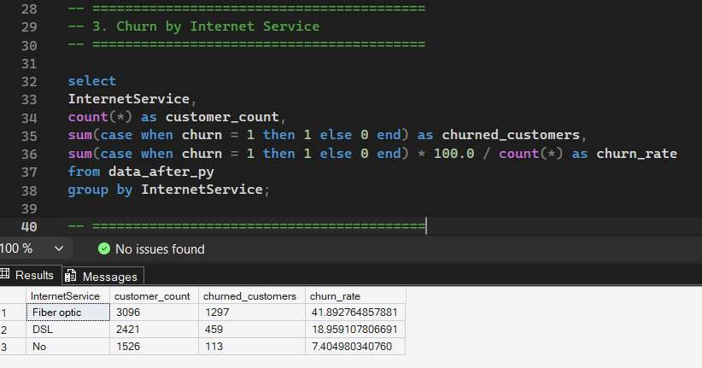
Churn by Internet Service
WHAT WAS DONE
Compared churn across the internet service types.
HOW
COUNT, SUM(CASE WHEN churn = 1 ...) and the churn rate, grouped by InternetService.
Key insight: Fiber optic customers churn at 41.89%, more than twice the DSL rate (18.96%) and over five times the rate with no internet (7.40%).
i
Notes:
What we did: Compared churn across the internet service types.
How: COUNT, SUM(CASE WHEN churn = 1 ...) and the churn rate, grouped by InternetService.
Key point: Fiber optic customers churn at 41.89%, more than twice the DSL rate (18.96%) and over five times the rate with no internet (7.40%).

Slide 21
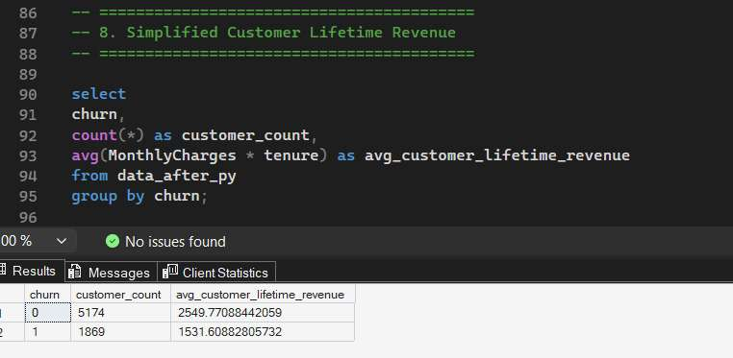
Customer Lifetime Revenue: Churned vs Retained
WHAT WAS DONE
Estimated how much revenue each group generated over its lifetime.
HOW
AVG(MonthlyCharges × tenure), grouped by churn. A simplified measure.
Key insight: Churned customers generated about $1,532 on average versus $2,550 for retained customers, about 40% less.
i
Notes:
What we did: Estimated how much revenue each group generated over its lifetime.
How: AVG(MonthlyCharges × tenure), grouped by churn. A simplified measure.
Key point: Churned customers generated about $1,532 on average versus $2,550 for retained customers, about 40% less.

Slide 22
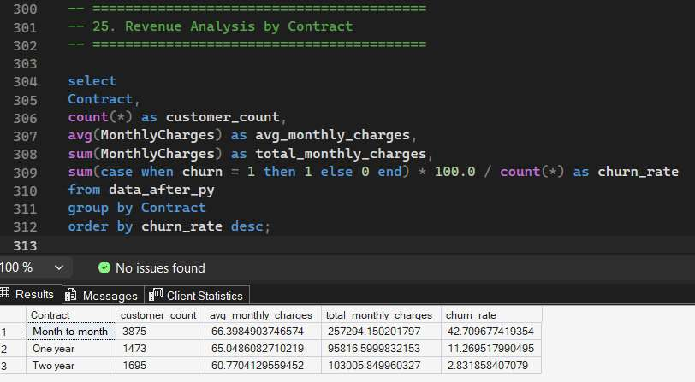
Revenue Analysis by Contract
WHAT WAS DONE
Compared customers, average and total monthly charges, and the churn rate for each contract.
HOW
COUNT, AVG and SUM of MonthlyCharges plus the churn rate, grouped by contract and ordered by churn rate.
Key insight: Month-to-month customers pay the most per month (about $66.40) and bring in $257K, 56% of all monthly charges, yet churn at 42.71%.
i
Notes:
What we did: Compared customers, average and total monthly charges, and the churn rate for each contract.
How: COUNT, AVG and SUM of MonthlyCharges plus the churn rate, grouped by contract and ordered by churn rate.
Key point: Month-to-month customers pay the most per month (about $66.40) and bring in $257K, 56% of all monthly charges, yet churn at 42.71%.

Slide 23
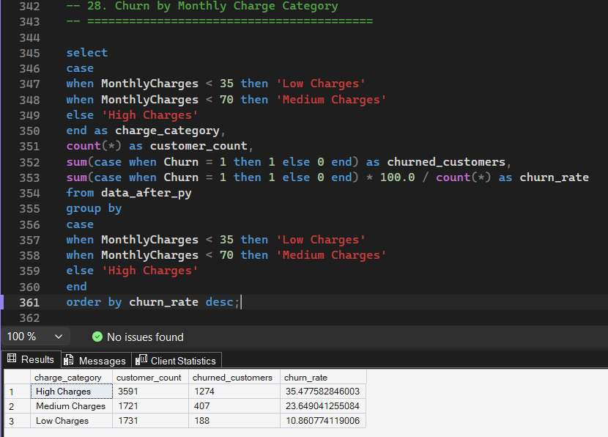
Churn by Monthly Charge Category
WHAT WAS DONE
Grouped customers into low, medium and high monthly charges and compared churn.
HOW
A CASE expression on MonthlyCharges: under 35, under 70, otherwise high; then the churn rate per group.
Key insight: The higher the monthly bill, the higher the churn: 35.48% for high charges versus 10.86% for low charges.
i
Notes:
What we did: Grouped customers into low, medium and high monthly charges and compared churn.
How: A CASE expression on MonthlyCharges: under 35, under 70, otherwise high; then the churn rate per group.
Key point: The higher the monthly bill, the higher the churn: 35.48% for high charges versus 10.86% for low charges.
Note: these thresholds (35 and 70) are separate from the Python spending segments (50 and 80).

Slide 24
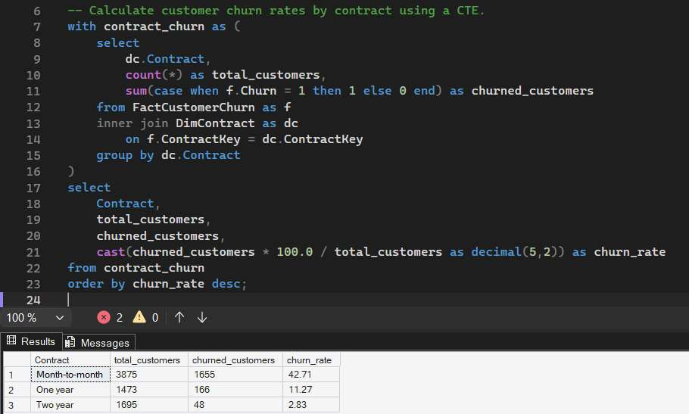
CTE: Churn Rate by Contract
WHAT WAS DONE
Counted customers and churners per contract inside a CTE, then calculated the churn rate.
HOW
WITH contract_churn AS (...) over FactCustomerChurn joined to DimContract, with the rate cast to decimal(5,2).
Key insight: The star schema gives the same answer as the raw table: 42.71%, 11.27% and 2.83%.
i
Notes:
What we did: Counted customers and churners per contract inside a CTE, then calculated the churn rate.
How: WITH contract_churn AS (...) over FactCustomerChurn joined to DimContract, with the rate cast to decimal(5,2).
Key point: The star schema gives the same answer as the raw table: 42.71%, 11.27% and 2.83%.

Slide 25
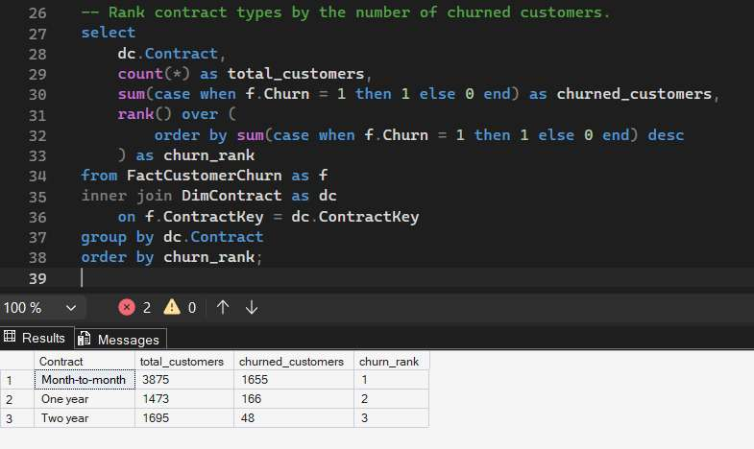
Ranking Contracts with RANK()
WHAT WAS DONE
Ranked the contract types by their number of churned customers.
HOW
RANK() OVER (ORDER BY SUM(CASE WHEN f.Churn = 1 ...) DESC).
Key insight: Month-to-month ranks first with 1,655 churned customers, ahead of one-year (166) and two-year (48).
i
Notes:
What we did: Ranked the contract types by their number of churned customers.
How: RANK() OVER (ORDER BY SUM(CASE WHEN f.Churn = 1 ...) DESC).
Key point: Month-to-month ranks first with 1,655 churned customers, ahead of one-year (166) and two-year (48).

Slide 26
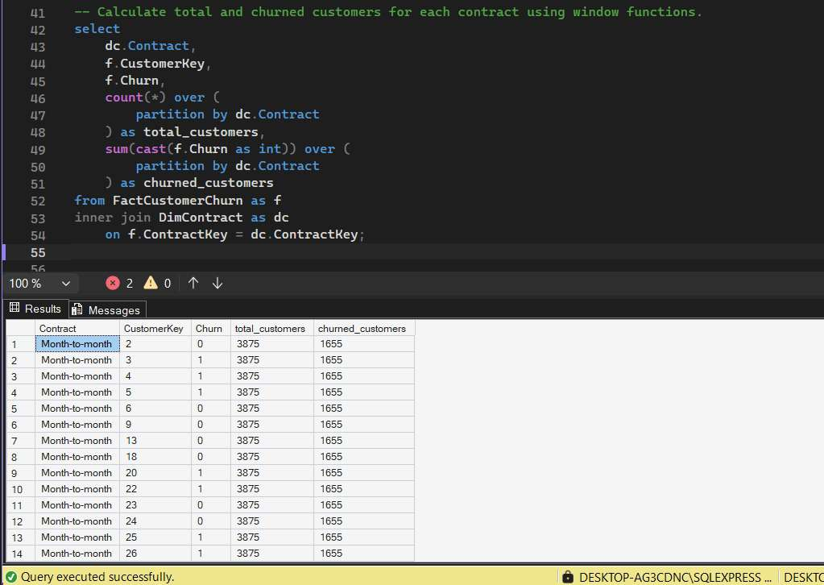
Window Functions: Totals per Contract
WHAT WAS DONE
Added each contract's total and churned customer counts to every customer row, without collapsing the rows.
HOW
COUNT(*) OVER (PARTITION BY dc.Contract) and SUM(CAST(f.Churn AS int)) OVER (PARTITION BY dc.Contract).
Key insight: Every month-to-month row carries its group totals: 3,875 customers and 1,655 churned.
i
Notes:
What we did: Added each contract's total and churned customer counts to every customer row, without collapsing the rows.
How: COUNT(*) OVER (PARTITION BY dc.Contract) and SUM(CAST(f.Churn AS int)) OVER (PARTITION BY dc.Contract).
Key point: Every month-to-month row carries its group totals: 3,875 customers and 1,655 churned.

Slide 27
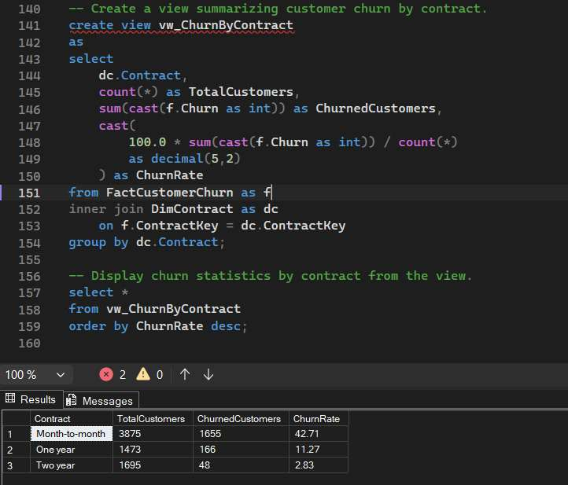
A Reusable View: vw_ChurnByContract
WHAT WAS DONE
Saved the contract churn summary as a view.
HOW
CREATE VIEW over the fact and contract tables, then SELECT * from the view ordered by ChurnRate.
Key insight: The view returns the same figures (42.71%, 11.27%, 2.83%) and can be queried directly by Power BI.
i
Notes:
What we did: Saved the contract churn summary as a view.
How: CREATE VIEW over the fact and contract tables, then SELECT * from the view ordered by ChurnRate.
Key point: The view returns the same figures (42.71%, 11.27%, 2.83%) and can be queried directly by Power BI.

Slide 28
Power BI Dashboard
03
Three interactive pages that turn the data into an executive view.
Notes:
Section 3: Power BI. The dashboard has three pages: Overview, Customer Insights and Financial Analysis.

Slide 29
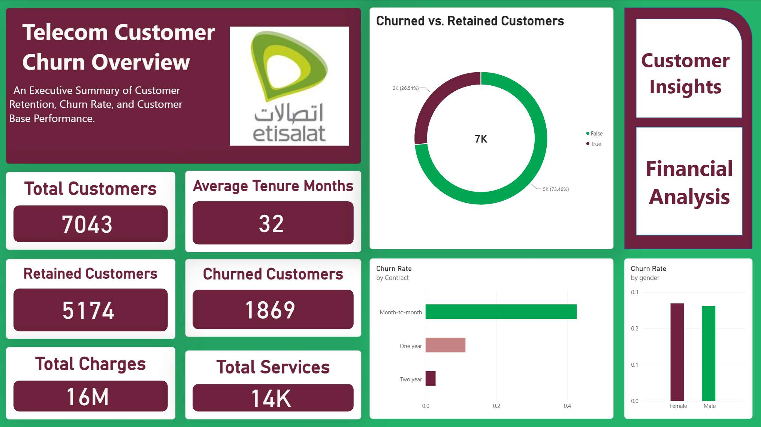
Overview Page
WHAT WAS DONE
An executive summary of customers, churn and contract performance.
HOW
KPI cards, a churned vs retained donut, churn rate by contract and gender, and buttons to the other pages.
Key insight: 7,043 customers, 1,869 churned (26.54%), and an average tenure of 32 months.
i
Notes:
What we did: An executive summary of customers, churn and contract performance.
How: KPI cards, a churned vs retained donut, churn rate by contract and gender, and buttons to the other pages.
Key point: 7,043 customers, 1,869 churned (26.54%), and an average tenure of 32 months.

Slide 30
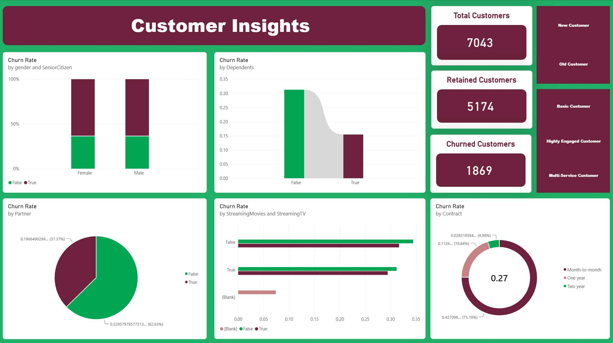
Customer Insights Page
WHAT WAS DONE
Explores churn across demographics and customer segments.
HOW
Churn-rate charts by gender, senior citizen, dependents, partner, streaming and contract, plus customer and service segment filters.
Key insight: Customers without dependents churn at about 31%, versus about 15.5% for customers with dependents.
i
Notes:
What we did: Explores churn across demographics and customer segments.
How: Churn-rate charts by gender, senior citizen, dependents, partner, streaming and contract, plus customer and service segment filters.
Key point: Customers without dependents churn at about 31%, versus about 15.5% for customers with dependents.

Slide 31
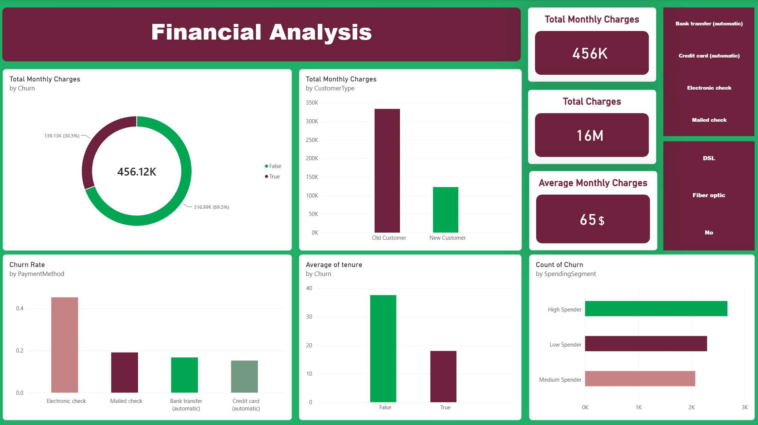
Financial Analysis Page
WHAT WAS DONE
Links churn to revenue, customer type and payment method.
HOW
Monthly charges by churn and customer type, churn by payment method, average tenure by churn, and payment and internet filters.
Key insight: Churned customers hold $139.13K (30.5%) of the $456.12K in monthly charges, and electronic check shows the highest churn.
i
Notes:
What we did: Links churn to revenue, customer type and payment method.
How: Monthly charges by churn and customer type, churn by payment method, average tenure by churn, and payment and internet filters.
Key point: Churned customers hold $139.13K (30.5%) of the $456.12K in monthly charges, and electronic check shows the highest churn.

Slide 32
Business Analysis
04
From numbers to decisions: KPIs, churn drivers, insights and recommendations.
Notes:
Section 4: Business analysis. We define the KPIs, identify what drives churn, extract the insights and turn them into recommendations.

Slide 33
Key KPIs: Churn Is Costly
CHURN RATE
RETENTION RATE
REVENUE TIED TO CHURN
26.5%
73.5%
30.5%
1,869 of 7,043 customers left
5,174 customers stayed
$139K of $456K in monthly charges
AVG MONTHLY BILL
AVG TENURE
MONTH-TO-MONTH SHARE OF CHURN
$74.4 vs $61.3
18 vs 38
88.6%
churned vs retained customers
months, churned vs retained customers
of all churners were on month-to-month contracts
Key insight: Churners pay more ($74.4 vs $61.3 a month) but stay about half as long (18 vs 38 months), and nearly 9 in 10 are on month-to-month contracts.
i
Notes:
Define the KPIs: churn rate = churned customers / total customers; retention rate = retained / total; revenue tied to churn = monthly charges of churned customers / total monthly charges.
Churners pay more and leave sooner.

Slide 34
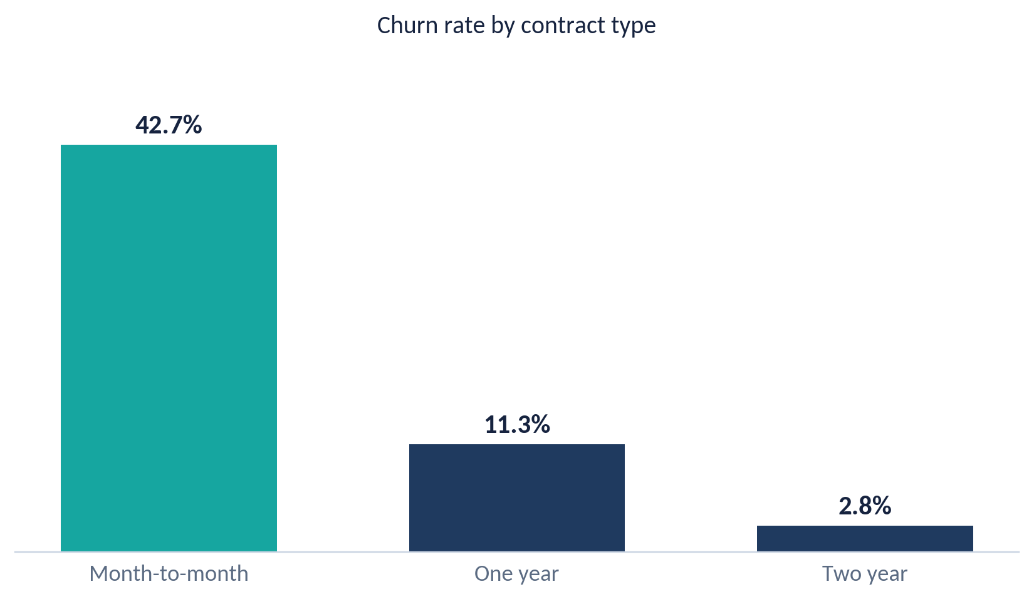
Contract Type Is the Biggest Driver
55.0%
of customers are on month-to-month contracts
88.6%
of all churn comes from month-to-month customers
Key insight: Moving customers off month-to-month is the biggest lever: two-year contracts churn at just 2.8%, against 42.7% for month-to-month.
i
Notes:
Month-to-month customers can leave at any time and do. Longer contracts keep customers.

Slide 35
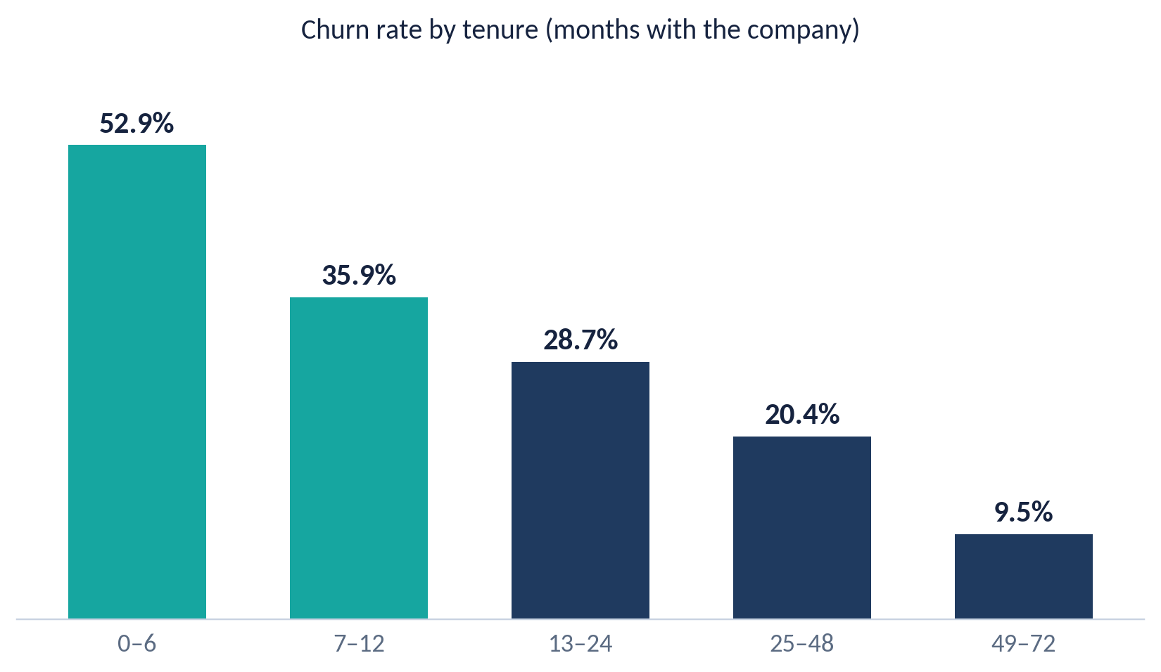
The First Year Is the Danger Zone
52.9%
churn in the first 6 months
55.5%
of all churners left within their first 12 months
Key insight: Churn falls steadily with tenure, from 52.9% in months 0 to 6 to 9.5% after four years, so early retention matters most.
i
Notes:
Most customers who leave do so early. Onboarding and early contracts are where the opportunity is.

Slide 36
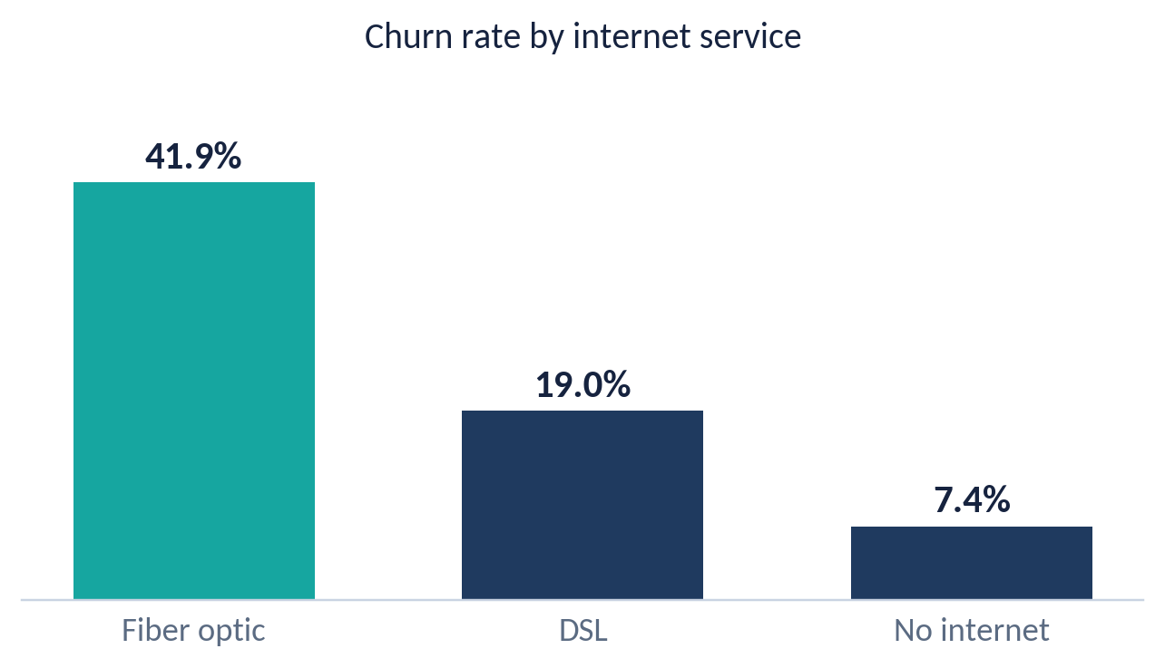
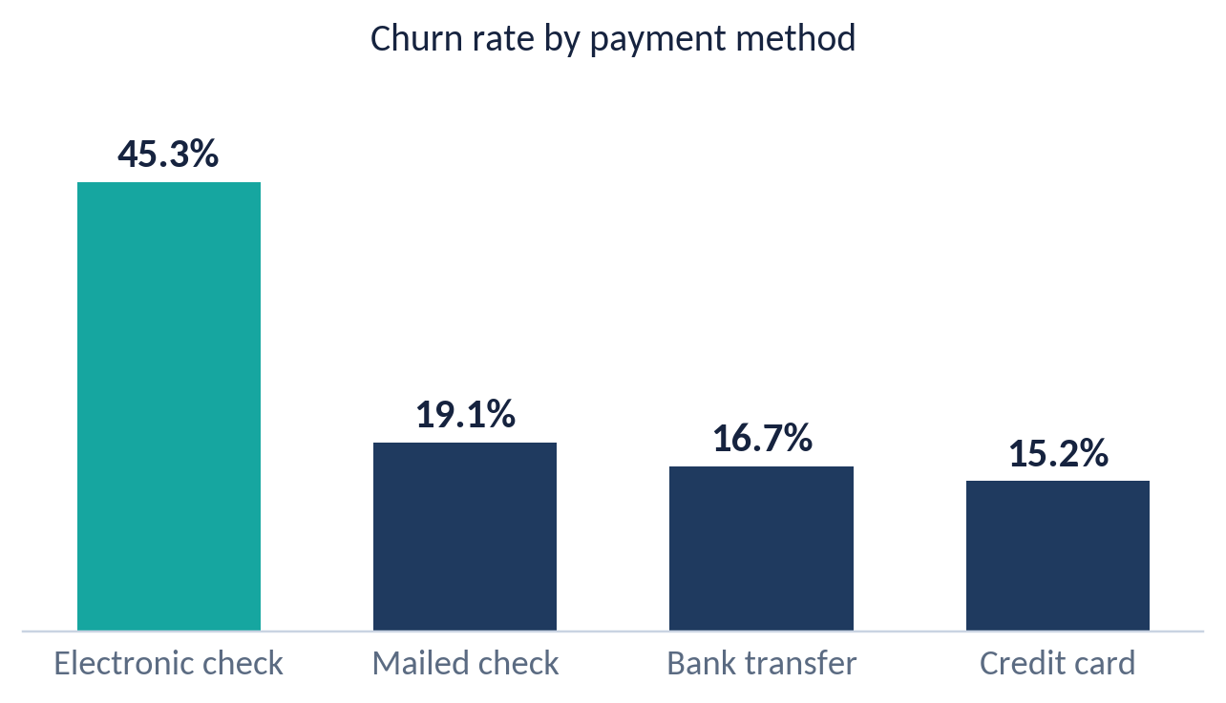
Fiber and Electronic Check Stand Out
Fiber is 44.0% of customers but 69.4% of churn.
Electronic check is 33.6% of customers but 57.3% of churn.
Key insight: Both effects hold within month-to-month contracts: fiber churns at 54.6% vs 32.2% for DSL, and electronic check at 53.7% vs 31.6% to 34.1% for other methods.
i
Notes:
Bank transfer and credit card are automatic payment methods. They are the stickiest.
The fiber and electronic-check effects remain even when we compare only month-to-month customers, so they are not just a contract effect.

Slide 37
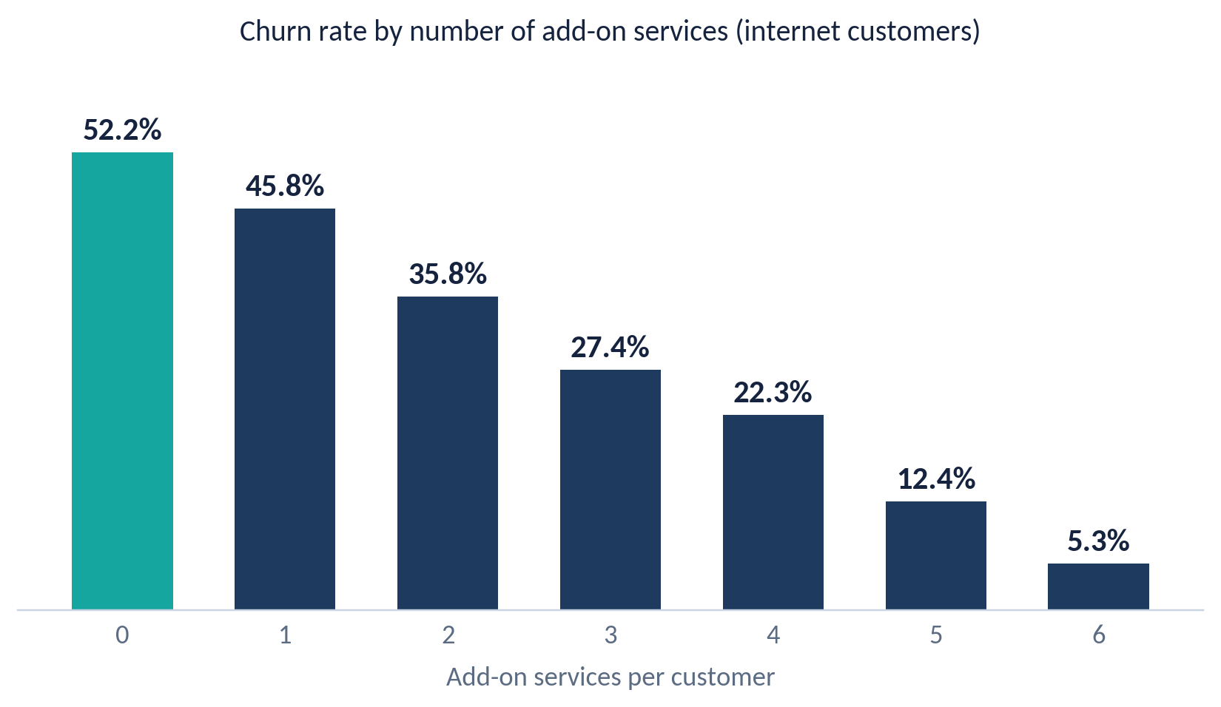
Support and Security Keep Customers
41.6% vs 15.2%
churn without vs with tech support
41.8% vs 14.6%
churn without vs with online security
Key insight: Each extra add-on lowers churn, from 52.2% with none to 5.3% with all six. Figures cover customers with internet service only.
i
Notes:
Customers without internet are excluded here, so the comparison is fair.
Add-ons may mark more engaged customers, so a free-trial test is the right way to confirm the effect.

Slide 38
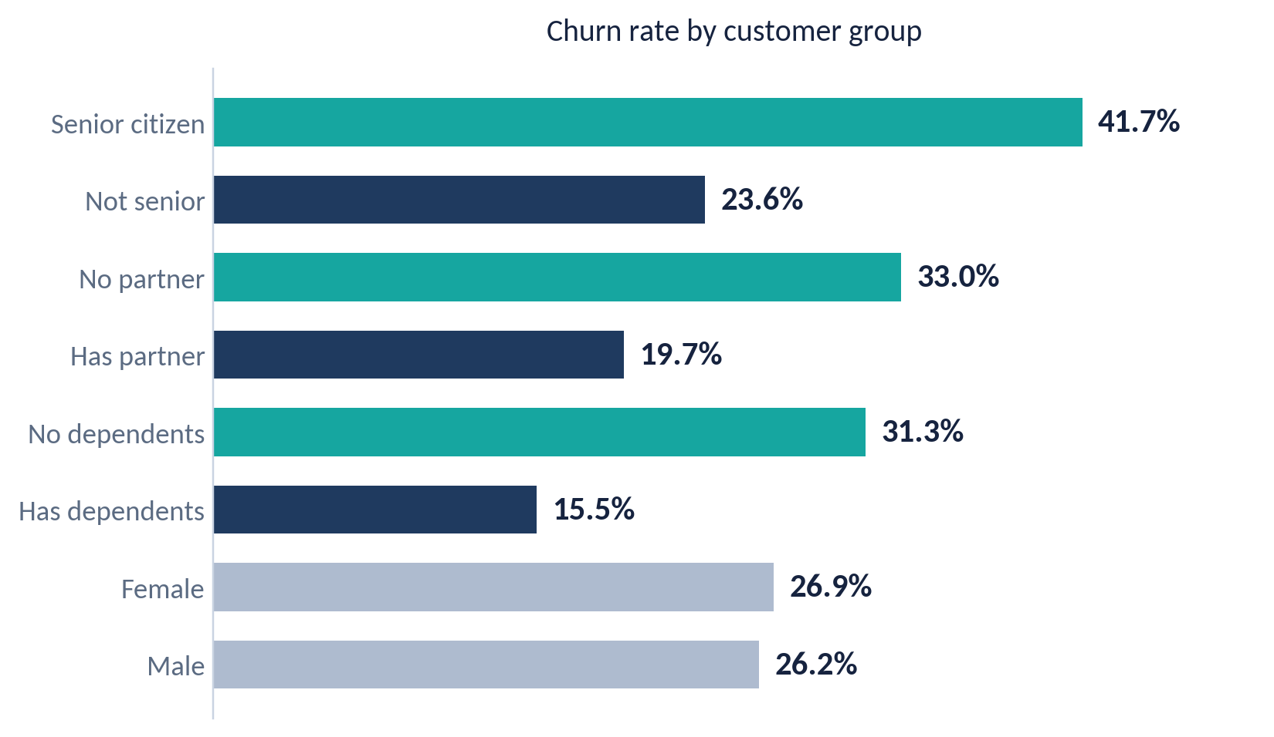
Who Is Most at Risk
34.2% vs 14.2%
churn: no partner and no dependents vs both
26.9% vs 26.2%
female vs male: gender is not a driver
Key insight: Seniors and customers without a partner or dependents churn the most, while gender makes no meaningful difference.
i
Notes:
Teal bars are the higher-risk groups, navy bars the comparison groups, gray bars the non-driver (gender).

Slide 39
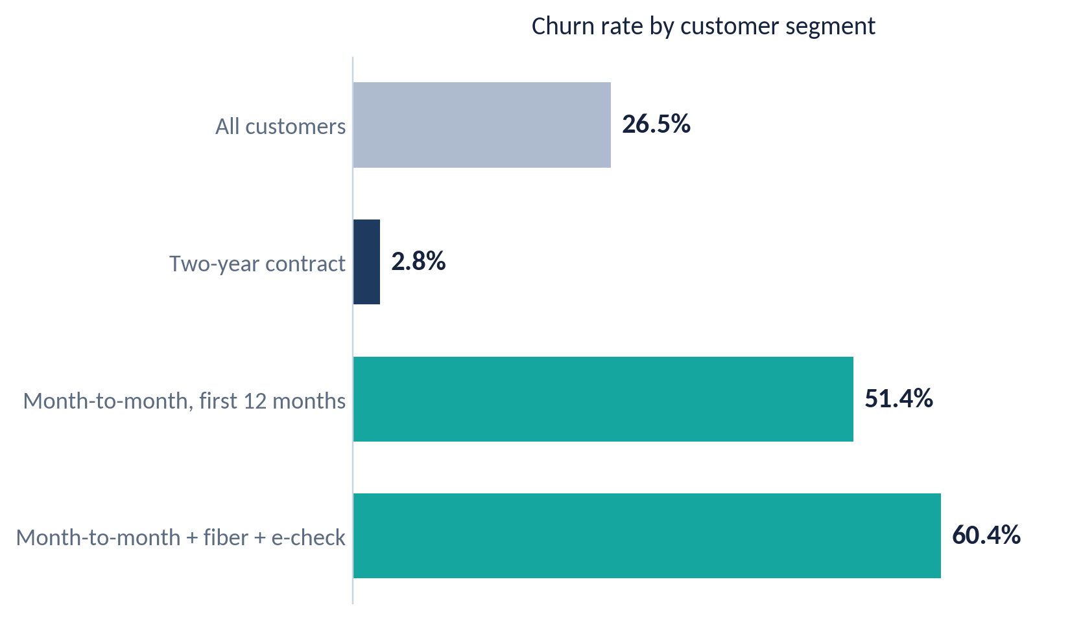
One Segment Drives 42% of Churn
1,307
customers (18.6% of the base) are month-to-month, on fiber and paying by e-check
42.2%
of all churn comes from that segment (789 churners)
Key insight: Month-to-month + fiber + electronic check customers are 18.6% of the base but 42.2% of churn, with a 60.4% churn rate.
i
Notes:
Combining the top three risk factors isolates a small group that accounts for a large share of churn. This is the natural target list for a retention team.

Slide 40
Recommendations: Lock In and Support
1
Move month-to-month customers to 12/24-month contracts
2
Build a first-90-days onboarding program
Offer a price lock, a discount or a free add-on for switching.
A welcome call, a check-in around day 30, and fast follow-up on early issues.
Churn: 42.7% vs 11.3% (1 yr) and 2.8% (2 yr)
52.9% churn in months 0–6; 55.5% of churn in year one
3
Fix the fiber experience and bundle support
4
Push tech support and online security
Review fiber quality and pricing; offer a support + security bundle, for example free for 3 months.
Run a free trial for internet customers who have neither service.
Within month-to-month: fiber 54.6% vs DSL 32.2%
About 15% churn with them vs about 42% without
Key insight: Contracts and onboarding go after the biggest pools of churn: month-to-month customers (88.6% of churn) and first-year customers (55.5%).
i
Notes:
Recommendations 1 to 4 target contract, onboarding, fiber and support. Each is tied to evidence from the previous slides.

Slide 41
Recommendations: Payments and Priorities
5
6
7
Move electronic-check payers to auto-pay
Simplify plans for seniors and singles
Give retention a priority at-risk list
Offer a small bill credit for switching to bank transfer or credit card.
A dedicated support line, simpler plans, and family or partner offers.
Month-to-month + fiber + e-check customers (1,307), newest first.
45.3% churn vs 15.2%–19.1% for other methods
Seniors 41.7%; no partner and no dependents 34.2%
60.4% churn; 42.2% of all churn
NOT WORTH PRIORITIZING
SCALE OF THE PRIZE
Gender-based campaigns, and streaming bundles as a retention tool. Neither moves churn much.
Every 10-point drop in churn in the at-risk segment keeps about 131 customers, roughly 7.0% of all churners.
Key insight: A priority list lets retention work focus on 1,307 customers who account for 42.2% of all churn.
i
Notes:
Recommendations 5 to 7: move payers to auto-pay, support seniors and singles, and give the retention team a prioritized list.
The scale estimate is simple arithmetic: 10% of 1,307 customers is about 131.

Slide 42
Caveats and Next Steps
1
Patterns, not proven causes
2
No “reason for leaving” data
3
Drivers overlap
Customers who choose long contracts or buy support may simply be more loyal to begin with.
The dataset shows who leaves, not why. Exit surveys are needed to confirm the drivers.
78.2% of e-check customers are month-to-month and 67.4% have fiber, so effects partly overlap.
NEXT STEPS
1
2
3
4
Pilot contract and onboarding offers as A/B tests
Run exit surveys to learn why customers leave
Review fiber network quality and pricing
Track churn KPIs monthly on the Power BI dashboard
Key insight: Treat these findings as strong signals to test with small pilots, not as guaranteed causes.
i
Notes:
Be clear about limits: these are patterns in the data, not proven causes. The next step is to test the ideas with small pilots before rolling them out.

Slide 43
Summary & Recommendations
1
Churn is concentrated, not random
26.5% overall, but 42.7% on month-to-month contracts versus 2.8% on two-year plans.
2
The first year is the danger zone
55.5% of churners left within 12 months, and churn is 52.9% in months 0 to 6.
3
Fiber, e-check and missing support mark risk
Fiber 41.9%, electronic check 45.3%; customers with tech support or security churn at about 15%.
4
One segment drives 42% of churn
Month-to-month + fiber + e-check: 18.6% of customers, 60.4% churn rate.
5
Act early, and test before scaling
Lock in contracts, onboard early, bundle support, push auto-pay, and A/B test first: these are patterns, not proven causes.
Notes:
Close with the five takeaways: concentrated churn, the first-year danger zone, the risk markers, the high-risk segment, and the plan to test before scaling.

Slide 44
Any Questions?
Telecom Customer Churn Analysis · DEPI Mini Project
Notes:
Open the floor for questions.

Slide 45
Thank You
Telecom Customer Churn Analysis · DEPI Mini Project
Notes:
Thank the audience.

